Slide 1
DSC 530 – Final project By: Jon f. Vasquez

Slide 2
The question and the hypothesis
What can different features of video games tell us about their critical reception?
Do different features have any apparent correlation to critic scores?
If critic scores go up or down at the same or similar rate as different features, then a correlation would possibly be supported, and a new insight on game development may be uncovered.

Slide 3
Data And variables
The topic and involved data is on video games and their features.
File is titled “gaming_w_features”
Five important variables:
Critic Review – “Metrics.Review Score”
Consoles – “Release.Console”
Length of playthrough – “Length.All PlayStyles.Average”
Rating – “Release.Rating”
Genre – “Metadata.Genres”

Slide 4
Variables
Critic Review – “Metrics.Review Score”
Scaled 0-100 – Critic Scores
Consoles – “Release.Console”
Which console the game was released on
Length of playthrough – “Length.All PlayStyles.Average”
Average time it takes for a player to play the entire game
Rating – “Release.Rating”
Game’s ESRB rating (E, T, M)
Genre – “Metadata.Genres”
The games genre

Slide 5
Histograms

Slide 6
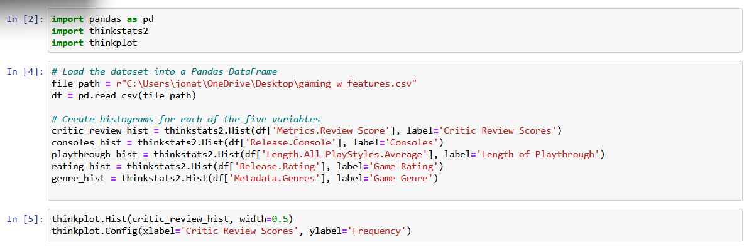
Create histograms

Slide 7
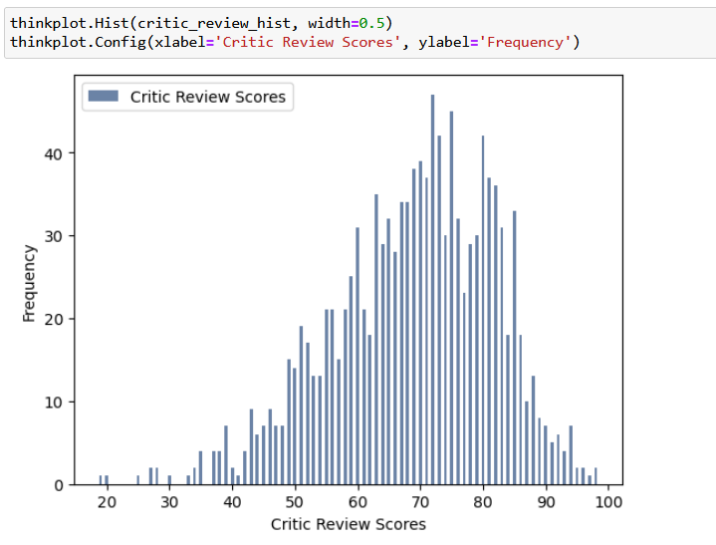
Plotted histograms
Clear that most reviews fall between 50-90, with a rare occurrence of less than 20 and near 100.
No clear outliers.

Slide 8
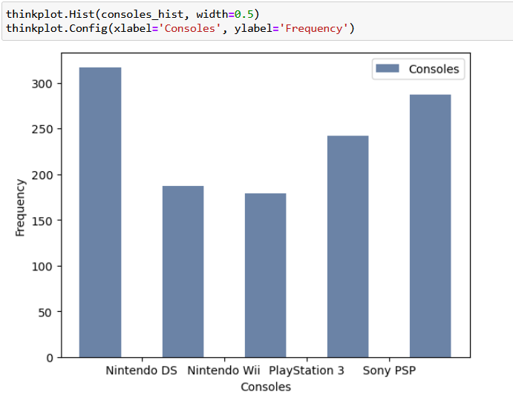
Plotted histograms
This data set covers mostly Nintendo games.
Visible distortion in the histogram, the data would need to be further cleaned for better clarity.

Slide 9
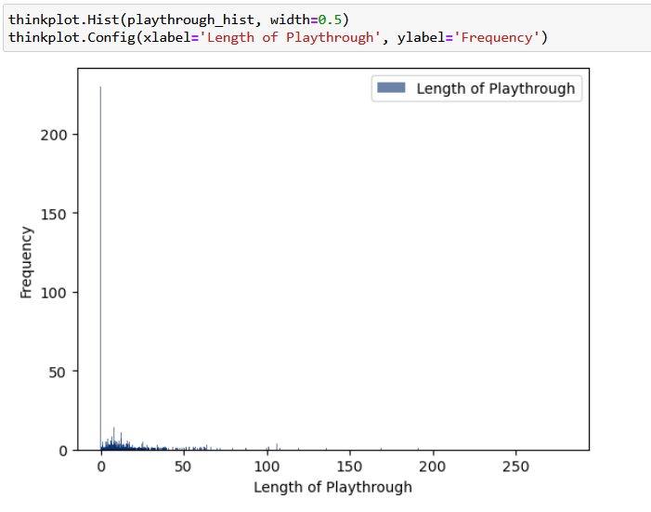
Plotted histograms
Clear outlier: 0.
This is due to missing values.
The way to handle this would be to thoroughly clean data and handle missing values and outliers like 0.
Outliers may be visible as “N/A” or 0 as a placeholder

Slide 10
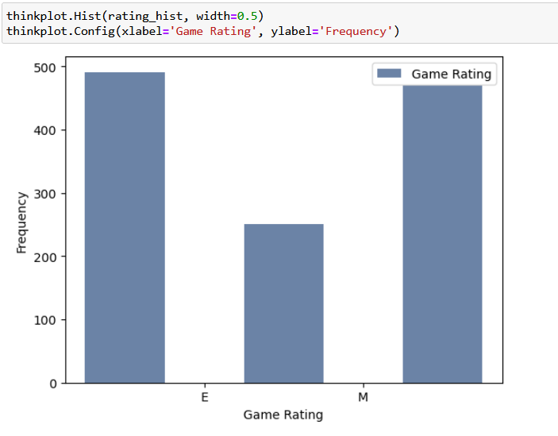
Plotted histograms
Data may need to be further cleaned for better clarity.
Most games fall under E and M, with T being a middle, lesser-used rating.

Slide 11
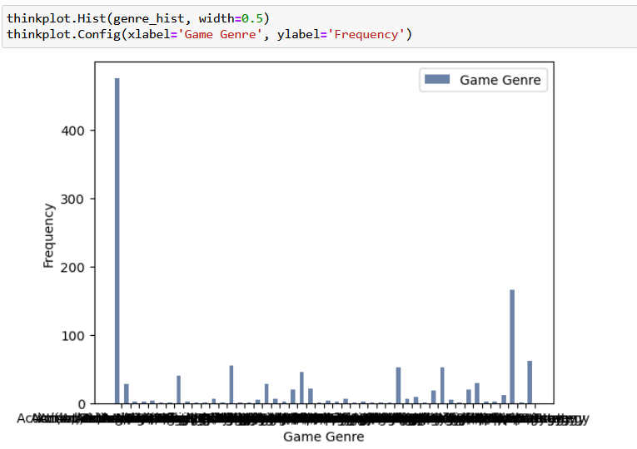
Plotted histograms
Clear that action/adventure is the outlier, but it may be that most games are A/A.
However, it may have been used as a placeholder to account for missing values.
I will assume it is not a placeholder.
Genre names are too long and vast to be placed into single histogram.

Slide 12
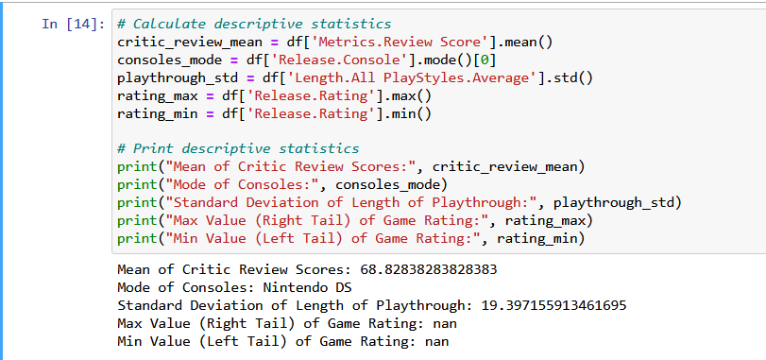
More descriptive stATISTICS
Game rating not being a numerical value may explain the nan.

Slide 13
PMfs/cDfs

Slide 14
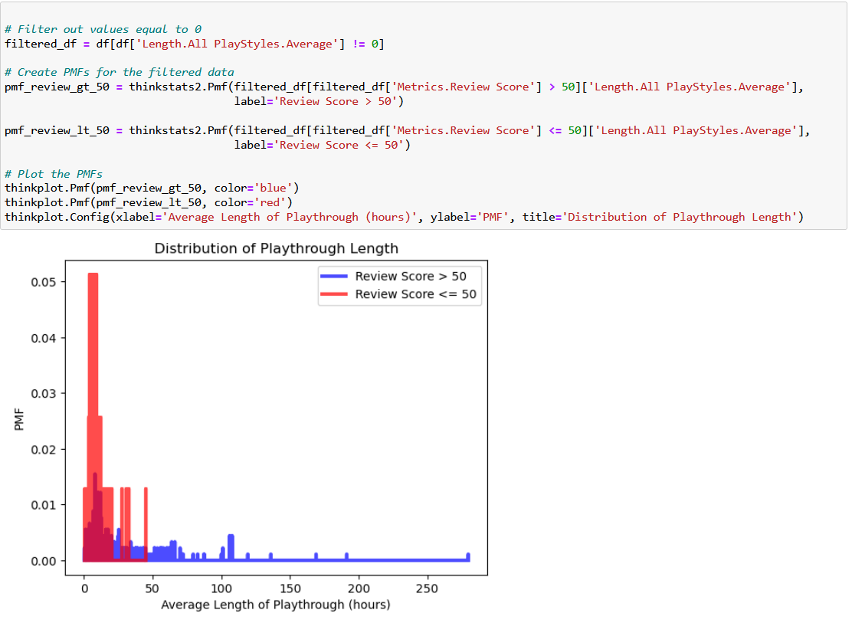
Length of playthrough and critic score above/below 50
Compared length of playthrough between games that are above 50 in critic score (blue) and below 50 in critic score (red)
Clear results are that games above 50 are typically longer.
Majority of scores below 50 fall under very short playthrough lengths.

Slide 15
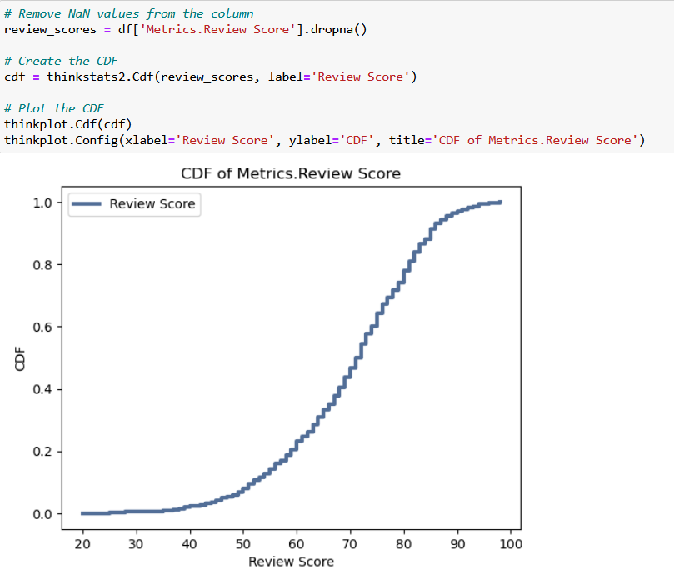
CdF of review scores
Median appears to be in the 60-80 range
Sharp peak at around 85

Slide 16
Analytical distribution

Slide 17
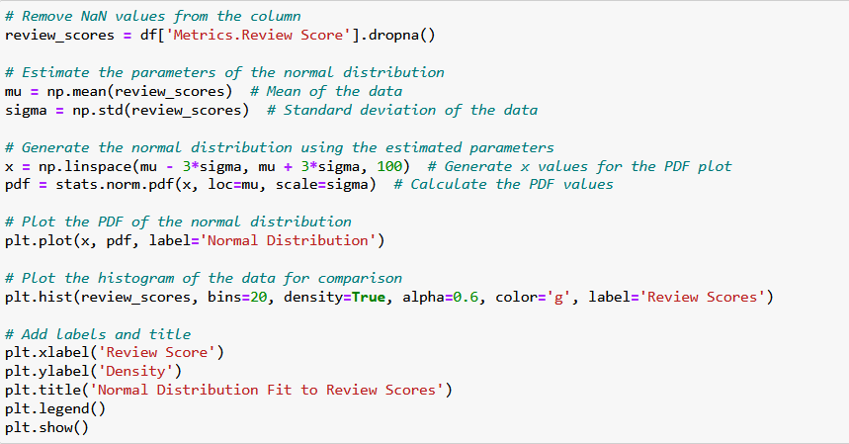
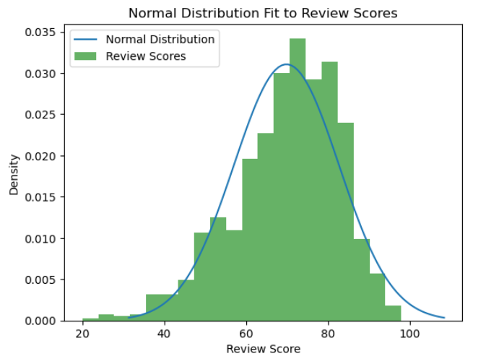
Normal/Actual distribution of review scores
Used Matplotlib to visualize Gaussian Distribution
Confirms that majority of scores fall above 60 and below 90
This helps analysis by showing what developers should count as a “good” score versus a “bad” score. 60 may seem bad, but in terms of distribution, it’s not bad in contrast to hundreds of other successful games.

Slide 18
scatterplots

Slide 19
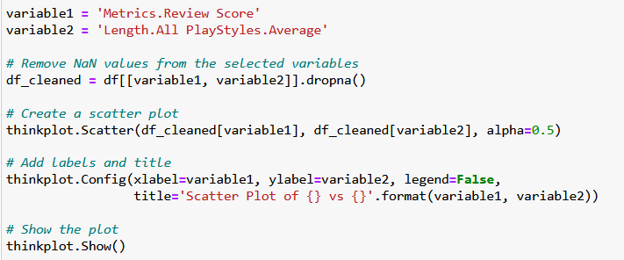
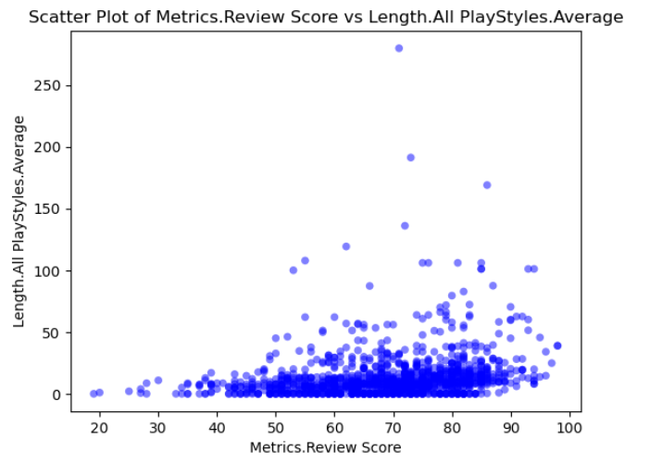
Reviews vs length of gameplay
Somewhat visible correlation between higher gameplay lengths and higher review scores.
The majority appear to follow normal distribution, with average gameplay correlating to average review scores. There is a slight uptick in gameplay length in association with review scores. Very slight.

Slide 20
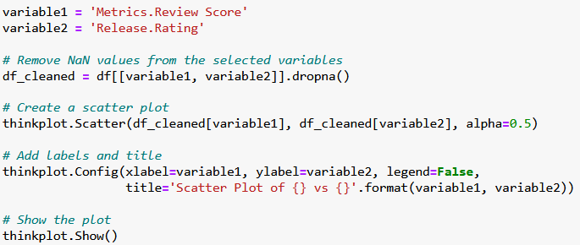
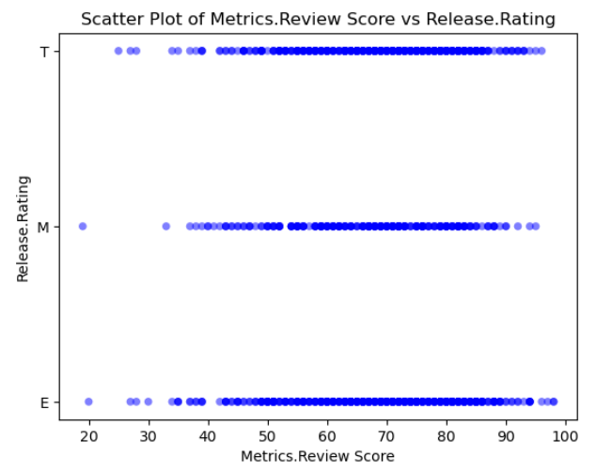
Rating vs reviews
Only 3 metrics (E, T, M)
M Games have slightly lower scores than E, which has the highest rated games.
T is in a close second

Slide 21
Hypothesis testing

Slide 22
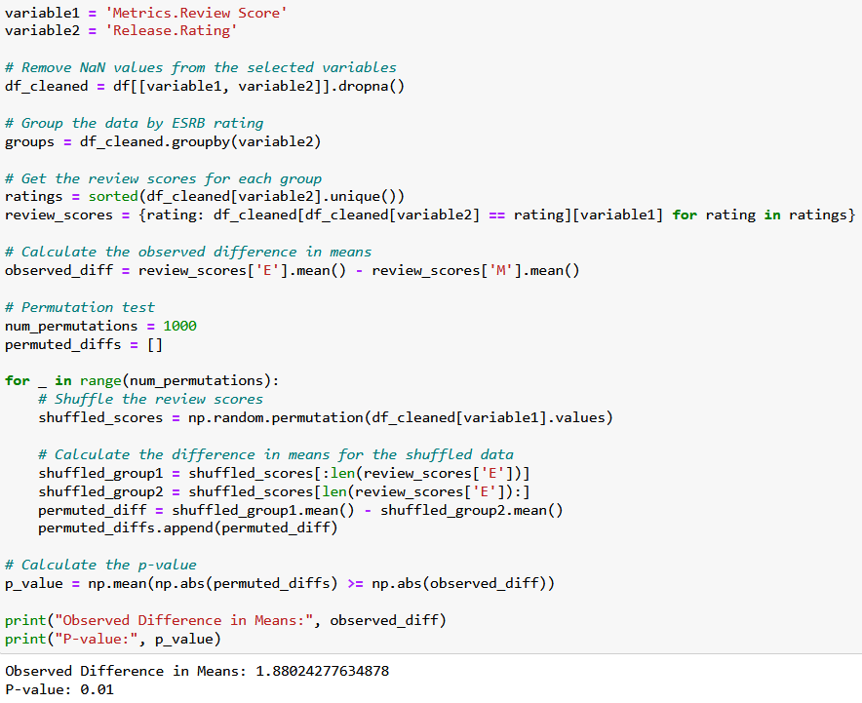
permutation test
Used permutation testing to test differences in means between reviews and ratings
Observed difference in means was ~1.88
This means on average, games with E ratings tend to have higher review scores compared to games with M ratings.
P-Value is 0.01
Since the p-value is less than the typical significance level of 0.05, we reject the null hypothesis.

Slide 23
Regression analysis

Slide 24
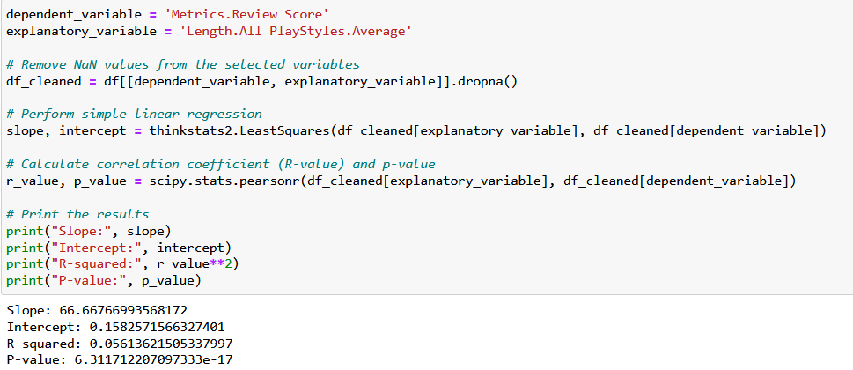
Reviews and length of playthrough
Slope is ~66.667
Every unit increase in the average length of playthrough, we expect the review score to increase by around 66.67 points
P value is ~6.311
Since this is a low p-value, we reject the null hypothesis and conclude that there is a statistically significant linear relationship between length of playthrough and the review scores.

Slide 25
conclusion

Slide 26
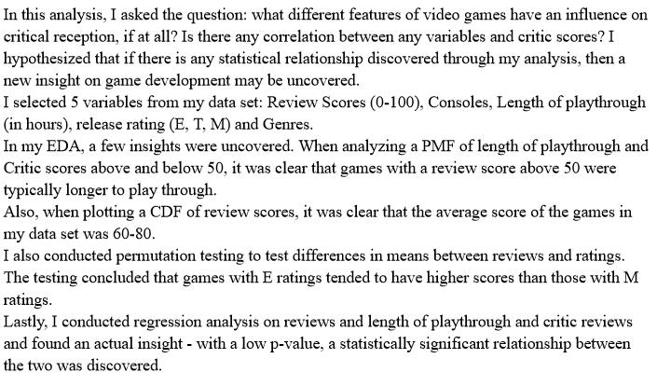

Slide 27
